Slide 1

EMOTION AI
NEIL SAWANT
SHREYA CHITTARI
GUIDE-
VAHID BEHZADAN

Slide 2
Emotion AI
Emotion AI refers to artificial intelligence that detects and interprets human emotional signals. The last thing a human expects is to replicate his own behaviour or expression and we are trying to build a model to predict one. The project focuses on 2 major points which are key point facial detection and facial expression prediction

Slide 3
Project Details
Key Facial Points Detection
Facial Expression detection
Artificial neural Networks
Gradient descent Algorithm
Convolutional Neural Networks
Resnets
Training and Testing data
Serve trained model in Tensorflow

Slide 4
Key Facial Points Detection
Dataset consists of x and y coordinates with 15 facial key points
The images are 96 by 96 pixels
The images are gray scale

Slide 5
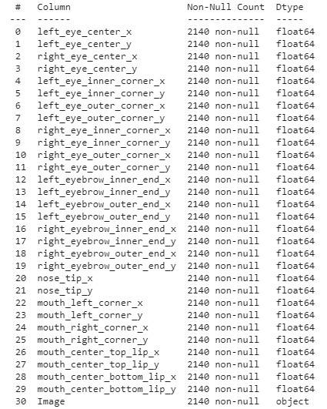
Key Facial Points Detection
The data set also conists of following variables

Slide 6
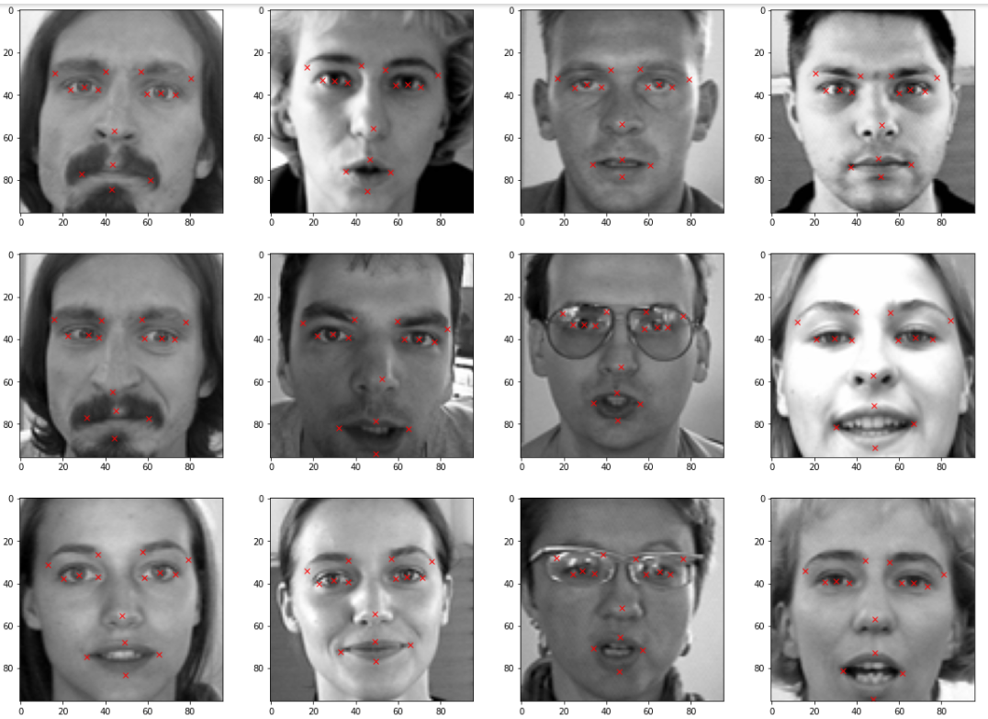
Image visualizations
Plotting random images from the dataset along with facial keypoints
Image data is obtained from df['Image'] and plotted using plt.imshow
Access their value using .loc command,where we get the values for coordinates of the image based on the column it is refering to.

Slide 7
Image Augmentation
Obtain the columns in the dataframe
Flip the images along y axis
Y coordinate remains same as we are flipping horizontally
Only x coordiante values would change, all we have to do is to subtract our initial x-coordinate values from width of the image(96)
Show Original image
Show Flipped image
Concatenate the original dataframe with the augmented dataframe
Increasing the brightness of the image

Slide 8
DATA NORMALIZATION AND TRAINING DATA PREPARATION
Obtain the value of images which is present in the 31st column
Normalize the images
Create an empty array of shape (x, 96, 96, 1) to feed the model
Iterate through the img list and add image values to the empty array after expanding it's dimension from (96, 96) to (96, 96, 1)
Convert the array type to float32
Obtain the value of x & y coordinates which are to used as target
Split the data into train and test data

Slide 9
Facial Expression detection
The dataset consists of images that belong to 5 categories:
Anger
Disgust
Sad
Happy
Surprise

Slide 10
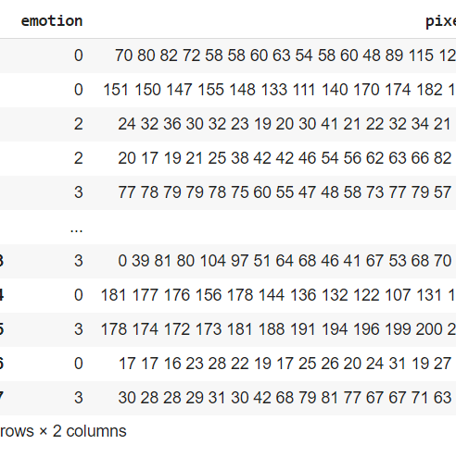
Facial Expression detection
Again we have another dataset as folows:

Slide 11
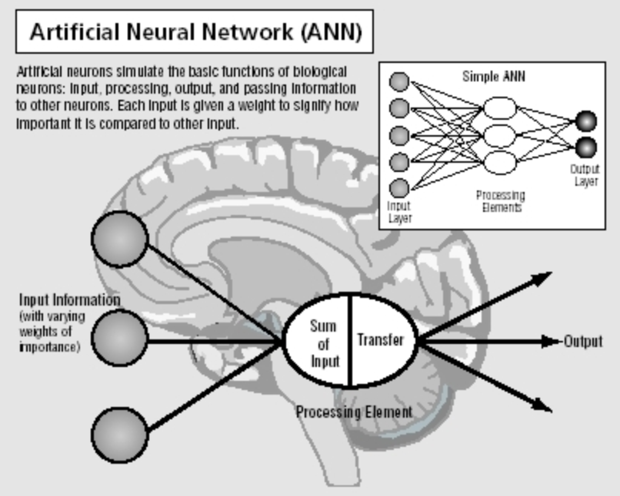
Artificial neural Networks
The brain has over 100 billion neurons communicating through electrical & chemical signals. Neurons communicate with each other and help us see, think, and generate ideas.
The brain has over 100 billion neurons communicating through electrical & chemical signals. Neurons communicate with each other and help us see, think, and generate ideas.
The neuron collects signals from input channels named dendrites, processes information in its nucleus, and then generates an output in a long thin branch called axon.

Slide 12
Gradient Descent
Gradient descent is an optimization algorithm used to obtain the optimized network weight and bias values
It works by iteratively trying to minimize the cost function
It works by calculating the gradient of the cost function and moving in the negative direction until the local/global minimum is achieved
If the positive of the gradient is taken, local/global maximum is achieved
The size of the steps taken are called the learning rate
If learning rate increases, the area covered in the search space will increase so we might reach global minimum faster

Slide 13
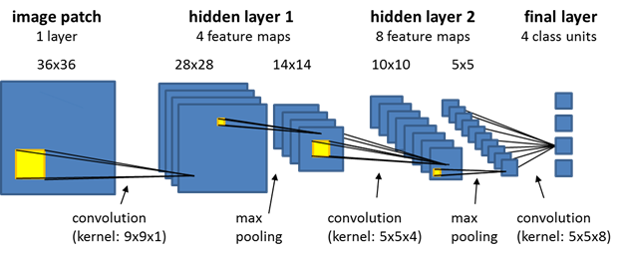
Convolutional Neural Networks
A Convolutional Neural Network (ConvNet/CNN) is a Deep Learning algorithm which can take in an input image, assign importance (learnable weights and biases) to various aspects/objects in the image and be able to differentiate one from the other. The pre-processing required in a ConvNet is much lower as compared to other classification algorithms. While in primitive methods filters are hand-engineered, with enough training, ConvNets have the ability to learn these filters/characteristics.

Slide 14
Resnets
As CNNs grow deeper, vanishing gradient tend to occur which negatively impact network performance.
Vanishing gradient problem occurs when the gradient is back -propagated to earlier layers which results in a very small gradient.
Residual Neural Network includes “skip connection” feature which enables training of 152 layers without vanishing gradient issues.
Resnet works by adding “identity mappings” on top of CNN
ImageNet contains 11 million images and 11,000 categories.
ImageNet is used to train ResNet deep network.

Slide 15
Training and Testing data
Data set is generally divided into 80% for training and 20% for testing.
Sometimes, we might include cross validation dataset as well and then we divide it into 60%, 20%, 20% segments for training, validation, and testing, respectively (numbers may vary).
Training set: Used for gradient calculation and weight update
Validation set: Used for cross -validation to assess training quality as training proceeds
Cross validation is implemented to overcome over-fitting which occurs when algorithm focuses on training set details at cost of losing generalization ability.
Testing set: Used for testing trained network

Slide 16
Serve Trained trained model in Tensorflow
Let’s assume that we already trained our model and it is generating good results on the testing data.
Now, we want to integrate our trained Tensorflow model into a web app and deploy the model in production level environment.
The following objective can be obtained using TensorFlow Serving. TensorFlow Serving is a high -performance serving system for machine learning models, designed for production environments.
With the help of TensorFlow Serving, we can easily deploy new algorithms to make predictions.
In -order to serve the trained model using TensorFlow Serving, we need to save the model in the format that is suitable for serving using TensorFlow Serving.
The model will have a version number and will be saved in a structured directory.
After the model is saved, we can now use TensorFlow Serving to start making inference requests using a specific version of our trained model "servable"

